Slide 1
Chapter 11
Organizational Design:
Structure, Culture, and Control

Slide 2
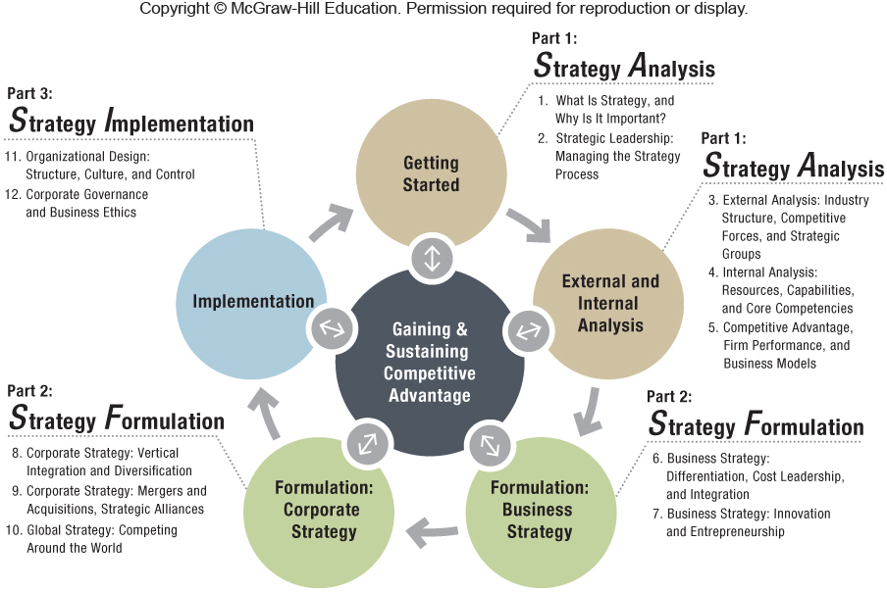

Slide 3
Chapter Outline
11.1 How to Organize for Competitive Advantage
11.2 Matching Strategy and Structure
11.3 Organizational Culture: Values, Norms, and Artifacts
11.4 Strategic Control-and-Reward Systems
11.5 Implications for the Strategist

Slide 4
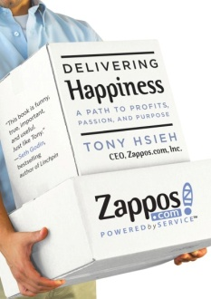
ChapterCase 11
Zappos: Designed to Deliver Happiness
Exceptional Customer Service → Core Competency
All customer service is done in-house.
No scripts or timed calls in the call centers
Keep its own stocked products… no drop-shipment
Flat Organizational Structure = Flexibility
Job rotation = widely trained talent
Internal promotion opportunities
Reorganized into 10 business units to manage growth
An independent subsidiary of Amazon since 2009
Photo courtesy of Zappos and the Delivering Happiness Team

Slide 5
11.1 How to Organize for Competitive Advantage
Organizational design
Goal is to translate strategies into realized ones
Structure, processes, and procedures
Implementation… the “graveyard of strategy”
Yahoo’s founder Jerry Yang was fired.
poor implementation….. lost 75% of market value
Structure follows strategies. (Alfred Chandler)
Therefore structure must be flexible.

Slide 6
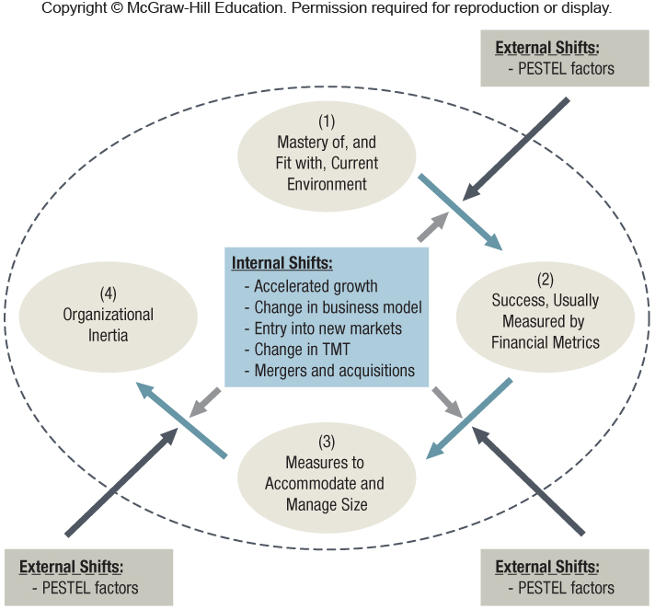
Exhibit 11.2 Organizational Inertia and the Failure of Established Firms When External or Internal Environments Shift

Slide 7
The Key Elements of Organizational Structure
Organizational structure:
Defines how jobs and tasks are divided and integrated
Delineates the reporting relationships up and down the hierarchy
Defines formal communication channels
Prescribes how individuals and teams coordinate their work efforts
The key building blocks of structure are: specialization, formalization, centralization, and hierarchy.

Slide 8
Strategy Highlight 11.1
W. L. Gore & Associates: Informality and Innovation
1958 – Founder Bill Gore articulated four core values that still guide the company today.
W. L. Gore is an informal and decentralized organization.
Empowered employees (no job titles, no job descriptions, informal team organization, soft reporting lines)
Face-to-face communication
All associates are shareholders of the company.
Gore: one of the largest privately held firms
10,000 employees and over $2.5 billion in revenues

Slide 9
Assembling the Pieces: Mechanistic vs. Organic Organizations
Organic organizations
Low degree of specialization and formalization
Flat structure
Decentralized decision making
Uses virtual teams due to information technology
Examples: Zappos and W. L. Gore
Mechanistic organizations
High degree of specialization and formalization
Tall hierarchy
Centralized decision making
Example: McDonald’s−Hamburger U in Chicago & China

Slide 10
11.2 Matching Strategy and Structure
Simple Structure
Functional Structure
Multidivisional Structure
Matrix Structure

Slide 11
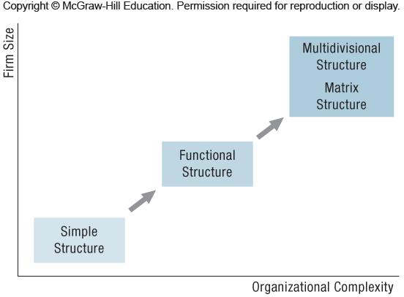
Exhibit 11.4 Changing Organizational Structures and Increasing Complexity as Firms Grow

Slide 12
Functional Structure
Groups of employees with distinct functional areas
The areas of expertise correspond to distinct stages in the company’s value chain activities.
Examples: College of Business Administration, strong CEO organizations
Recommended with limited diversification
Matches well with business-level strategy
Cost leadership Mechanistic organization
Differentiation Organic organization
Integration strategy Ambidextrous organization

Slide 13
Strategy Highlight 11.2
USA Today: Leveraging Ambidextrous Organizational Design
USA Today: one of the biggest print circulations in U.S.
Used an ambidextrous organizational design to successfully reintegrate its independent online unit
USA Today.com created as an in-house startup
Has large cultural differences and is separated from the print biz
Starved for corporate resources despite initial success
USA Today and USA Today.com then integrated,
Leveraging synergies and changing senior team incentives.
General managers key to finding synergies.

Slide 14
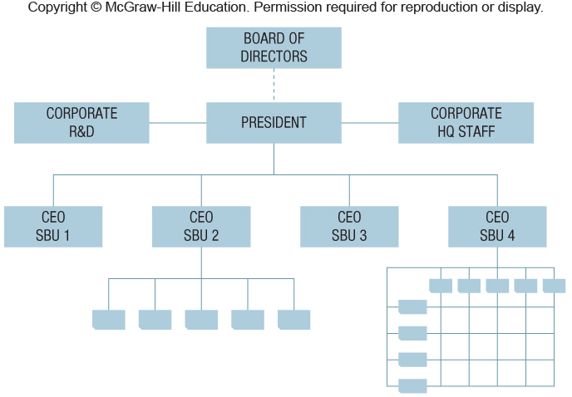
Exhibit 11.7 Typical Multidivisional (M-Form) Structure
(Note that SBU 2 uses a functional structure and SBU 4 uses a matrix structure.)

Slide 15
Multidivisional Structure (cont’d)
Use with various corporate strategies
Related diversification
Co-opetition among SBUs
Transfer core competences across SBUs
Centralized decision making
Unrelated diversification
Decentralized decision making
Competing for resources

Slide 16
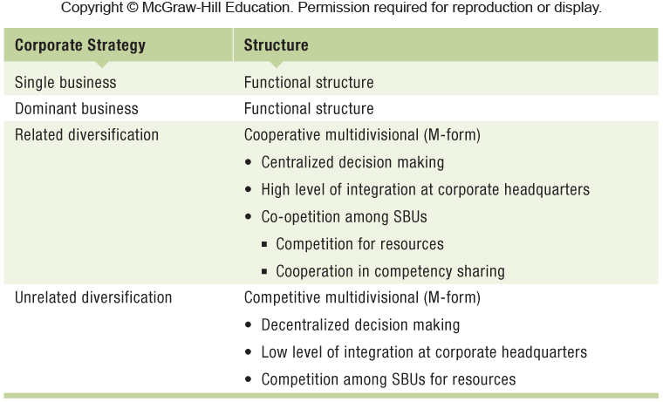
Exhibit 11.8 Matching Corporate-Level Strategy and Structure

Slide 17
Matrix Structure
A combination of functional and M-form structure
Creation of dual line of authority and reporting lines
Each SBU receives support both horizontally and vertically
Very versatile
Enhanced learning from different SBUs
Shortcomings
Difficult to implement
Complexity increases when expanding, especially globally
Unclear reporting structure causes confusion and delays

Slide 18
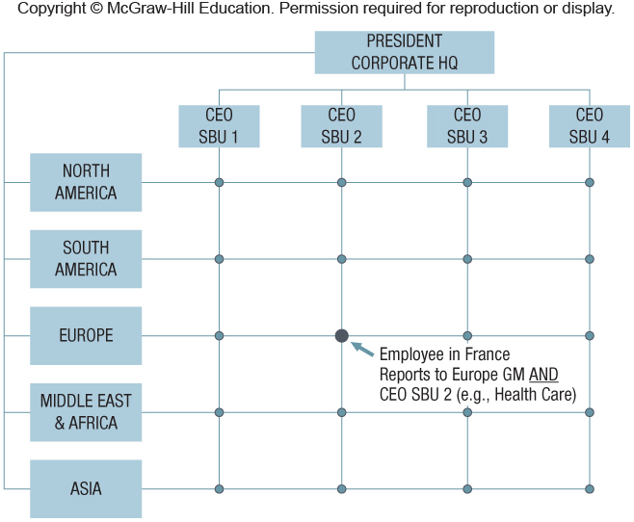
Exhibit 11.9 Typical Matrix Structure with Geographic and SBU Divisions

Slide 19
11.3 Organizational Culture: Values, Norms, and Artifacts
Organizational culture
Collectively shared values and norms
Value: what is considered important
Norms: appropriate employee behaviors and attitudes
Artifacts: expression of culture in items such as physical design, stories, and celebrations
Socialization
Internalize organization’s value and norms through interactions
Think of Zappos’ core values

Slide 20
Where Do Organizational Cultures Come From?
Founder imprinting
Founders defined and shaped the culture
Apple (Steve Jobs)
Microsoft (Bill Gates)
Harpo Productions (Oprah Winfrey)
Walmart’s “low cost” culture by Sam Walton
Recruit people that fit the culture
Zappos pays new hires if they want to…. quit!

Slide 21
Organizational Culture and Competitive Advantage
Culture must be valuable, rare, inimitable, and non-substitutable (VRIO see Ch. 4).
Protected by causal ambiguity and social complexity
Culture affects behavior and firm performance:
Southwest Airlines (SWA)
SWA’s unique culture helps it keep costs low by turning around its planes faster, thus keeping them flying longer hours.
Zappos
Zappos’ “WOW” customer experience is accomplished by “going the extra mile.” Long-term superior experience does increase the company’s perceived value and its economic value creation.

Slide 22
11.4 Strategic Control-and-Reward Systems
Internal governance mechanisms
Culture
Sanctions
Input controls
Budgets
Rules and standard operating procedures
Output controls
Result-oriented
ROWEs -3M; 15% work on own projects
Not directed from the top

Slide 23
11.5 Implications for the Strategist
Formulating effective strategies
Necessary but not sufficient condition
To gain and sustain competitive advantage
Strategy execution is at least as important for success.
SWOT helps operationalize strategy implementation.
Strategy implementation requires managers to design and shape structure, culture, and control mechanisms.
Strategy formulation and implementation
Iterative and interdependent activities

Slide 24
ChapterCase 11
Consider This…
What would you do if a programming error cost your firm $1.6 million?
Zappos put their money where their “WOW” is.
Zappos accidentally capped the price at $49.95 for all products sold on its subsidiary site at midnight, and the mistake was not discovered until 6 a.m.
Consistent with their “WOW” philosophy, Zappos honored all sales during this time period.
Photo courtesy of Zappos and the Delivering Happiness Team

